Slide 1
CROP PROTECTION FROM ANIMALS USING CNN
TEAM NO : 14
TEAM MEMBERS : JEYDHEEPAN J
ARVINTH S
HARIKRISHNAN M
SURYAKANTH S

Slide 2
INTRODUCTION
Agriculture is the most important sector of Indian Economy
The issue of damage to crops by wild creatures has turned into a noteworthy social issue in current occasions.
Existing methods include building wire fences and electric fences which are not so effective.
Thus Artificial Intelligence has brought a new solution to crop protection in an effective way

Slide 3
EXISTING PROBLEM
Electric fences inflict shock on animals and also there is a possibility of fire hazard if plants or shrubs grow too close to fence.
If the fence is not maintained properly, it creates electromagnetic interferences which affect telephone and radio transmissions.
Electric fencing is lethal to both animal and human life though it is the most commonly used farm protection technique.
Thorn fencing which is likewise a pervasive strategy followed has a similar impact as the previous

Slide 4
PROPOSED SOLUTION
This project provides a smart solution to resolve this problem.
In this framework, image is captured when an animal intrudes using Convolution Neural Network (CNN) and deep learning technique.
This classification helps in alerting the ultrasonic electronic repellent sensor to send waves according to the animal without harming them physicaly.
The smart farm protection system gives reliable security and safety to crops.
This system guarantees the wellbeing of creatures while warding them off.
It likewise diminishes the exertion made by man in securing the field.

Slide 5
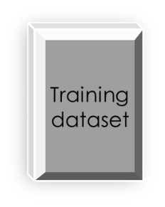



FLOWCHART
Feature
vectors
Machine
Learning Algorithms
Labels
Feature
vectors
Predictive
model
output

Slide 6
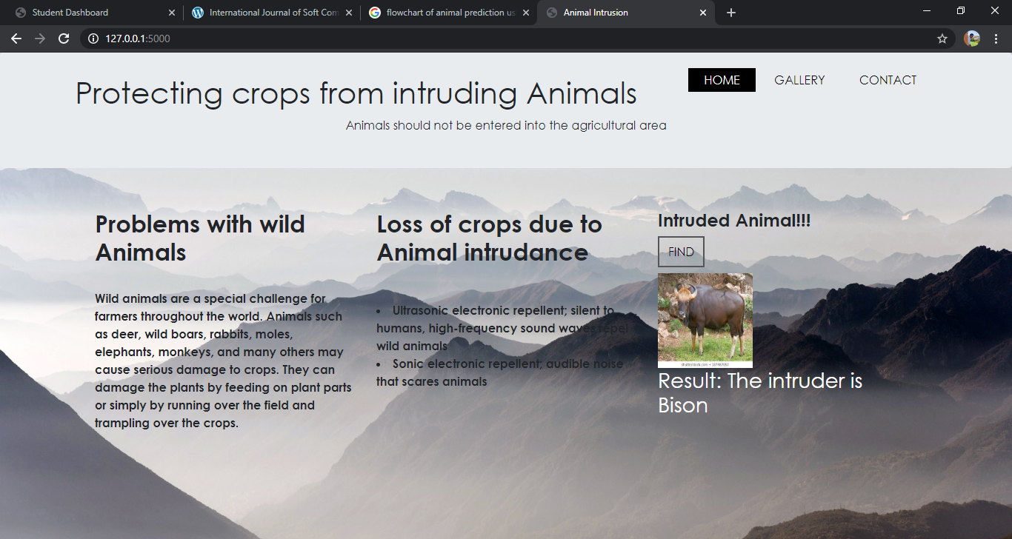
RESULT

Slide 7
CONCLUSION
Prototype of a crop protection system been developed which distinguishes the animals and can be used to ward them off.
Nowadays the issue of farm vandalization by wild creatures has turned into a major social issue.
It requires dire consideration as no viable solution exists till date for this issue.
This project is exceptionally viable in driving off the animals from the fields and keeps them away.
Implementation of the crop protection system can be done in a large scale also with multiple sensors at different nodes.
This will save and alert the people nearby. As a future work, if latency needs to be very low, edge/fog computing can be used.

